Slide 1
Project Report on
Decode Gaming Behaviour
By
Shibasis Karmakar
Internship Program
Under the Guidance of:
Mentorness

Slide 2
DECLARATION
I, Shibasis Karmakar, a working professional , have completed my Graduation from Calcutta University in 2010 on B.com(h). The Project Report on A Study on Decode Gaming Behaviour in fulfilment of Internship program from Mentorness is the original work conducted by me.
The information and data given in the report is authentic to the best of my knowledge. This report has not been submitted to any other university for the award of any other degree, diploma and fellowship.
Shibasis Karmakar
Place: West Bengal(Kolkata)
Date of submission: 21/04/2024

Slide 3
Project Title Decode Gaming Behaviour
Data Sources
Data Sets
Tools used
Provided by Mentorness
Internship Project
Via Email.
Dataset includes two tables : `Player Details 'and `Level Details`.
Software: Excel, My SQL Workbench
Hardware: AMD Ryzen 3 2200G with Radeon Vega Graphics 3.50 GHz
Ram:8.00 GB.
Edition: Windows 10 pro

Slide 4
Introduction/Brief Description on Dataset
Player Details Table:
`P_ID`: Player ID
`PName`: Player Name
`L1_status`: Level 1 Status
`L2_status`: Level 2 Status
`L1_code`: System generated Level 1 Code
`L2_code`: System generated Level 2 Code
Level Details Table:
`P_ID`: Player ID
`Dev_ID`: Device ID
`start_time`: Start Time
`stages_crossed`: Stages Crossed
`level`: Game Level
`difficulty`: Difficulty Level
`kill_count`: Kill Count
`headshots_count`: Headshots Count
`score`: Player Score
`lives_earned`: Extra Lives Earned

Slide 5
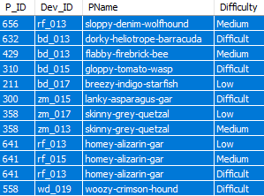
Q1) Extract P_ID,Dev_ID,PName and Difficulty_level of all players at level 0
SQL Query
select table1.P_ID,Dev_ID,PName,Difficulty FROM level_details2 as table1left join player_details as table2 on table1.P_ID =table2.P_IDwhere table1.Level= 0;
Result

Slide 6

Q2) Find Level1_code wise Avg_Kill_Count where lives_earned is 2 and atleast 3 stages are crossed
Result
SQL Query
select table2.L1_Status,avg(Kill_Count) from level_details2 as table1left join player_details as table2 on table1.P_ID =table2.P_IDwhere table1.Lives_Earned = 2 and table1.Stages_crossed>=3 group by table2.L1_Status;

Slide 7

Q3) Find the total number of stages crossed at each diffuculty level where for Level2 with players use zm_series devices. Arrange the result-- in decsreasing order of total number of stages crossed.
Result
SQL Query
Select table1.Difficulty,sum(Stages_crossed) as 'Total number of stages crossed' from level_details2 as table1left join player_details as table2 on table1.P_ID =table2.P_IDwhere table1.Level = 2 and table1.Dev_ID like 'zm%'group by table1.Difficulty order by 'Total number of stages crossed' desc;

Slide 8
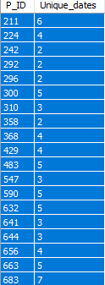
Q4) Extract P_ID and the total number of unique dates for those players who have played games on multiple days.
Result
SQL Query
select P_ID,count(distinct(TimeStamp)) as Unique_dates from level_details2 group by P_ID having count(distinct(TimeStamp)) >1;

Slide 9
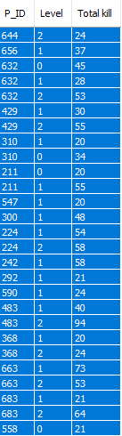
Q5) Find P_ID and level wise sum of kill_counts where kill_count is greater than avg kill count for the Medium difficulty.
Result
SQL Query
select P_ID,Level,sum(Kill_Count) as 'Total kill' from level_details2where Kill_Count > (select avg(Kill_Count) from level_details2where Difficulty = "Medium") group by P_ID,Level;

Slide 10
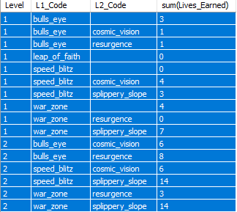
Q6) Find Level and its corresponding Level code wise sum of lives earned excluding level 0. Arrange in asecending order of level.
Result
SQL Query
select table1.Level,table2.L1_Code,table2.L2_Code,sum(Lives_Earned) from level_details2 as table1left join player_details as table2 on table1.P_ID =table2.P_IDwhere table1.Level <> 0 group by table1.Level,table2.L1_Code,table2.L2_Code order by table1.Level;

Slide 11
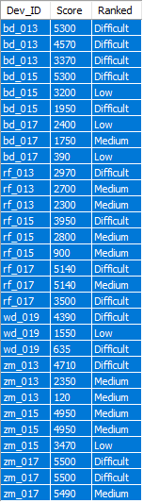
Q7) Find Top 3 score based on each dev_id and Rank them in increasing order using Row_Number. Display difficulty as well.
Result
SQL Query
with new_table as (select Dev_ID,Difficulty,Score, row_number() over(partition by Dev_ID order byScore desc) as Ranked from level_details2)select Dev_ID,Score,Difficulty Ranked from new_table where Ranked<=3;

Slide 12
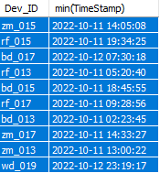
Q8) Find first_login datetime for each device id
Result
SQL Query
select Dev_ID,min(TimeStamp) from level_details2 group by Dev_ID;

Slide 13
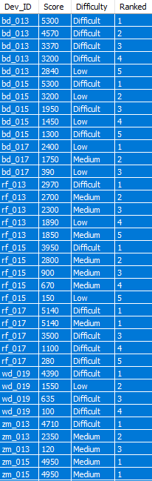
Q9) Find Top 5 score based on each difficulty level and Rank them in increasing order using Rank. Display dev_id as well.
Result
SQL Query
with new_table as (select Dev_ID,Score,Difficulty, rank() over(partition by Dev_ID order byScore desc) as Ranked from level_details2)select Dev_ID,Score,Difficulty, Ranked from new_table where Ranked<=5;

Slide 14
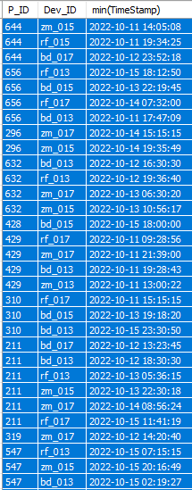
Q10) Find the device ID that is first logged in(based on start_datetime) for each player(p_id). Output should contain player id, device id and first login datetime.
Result
SQL Query
select P_ID,Dev_ID,min(TimeStamp) from level_details2 group by Dev_ID,P_ID;

Slide 15
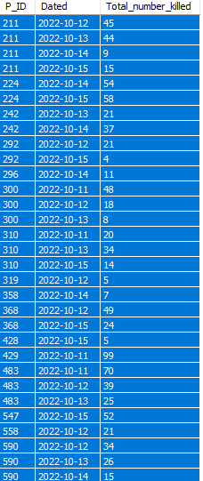
Q11) For each player and date, how many kill_count played so far by the player. That is, the total number of games played -- by the player until that date.-- a) window function
Result
SQL Query- With Window Function
select distinct P_ID, cast(TimeStamp as Date) as Dated, sum(Kill_Count)over(partition by P_ID,cast(TimeStamp as Date) order by cast(TimeStamp as Date))as Total_number_killed from level_details2 order by P_ID,Dated;

Slide 16
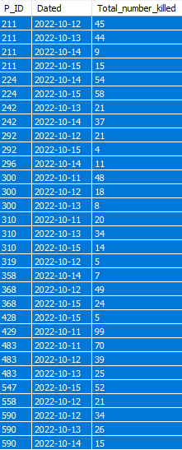
Q11) For each player and date, how many kill_count played so far by the player. That is, the total number of games played -- by the player until that date.-- b) Without window function
Result
SQL Query- Without Window Function
select P_ID, cast(TimeStamp as Date) as Dated, sum(Kill_Count)as Total_number_killed from level_details2 group by P_ID,cast(TimeStamp as Date) order by P_ID,Dated;

Slide 17
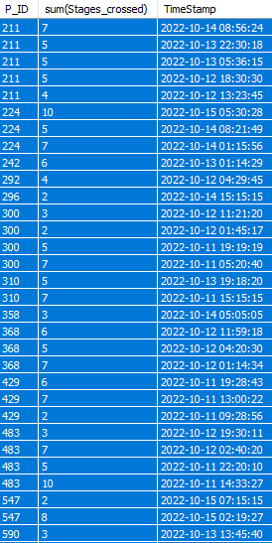
Q12) Find the cumulative sum of an stages crossed over a start_datetime for each player id but exclude the most recent start_datetime
Result
SQL Query
with task as (select P_ID,Stages_crossed,TimeStamp,row_number() over(partition by P_ID order byTimeStamp desc) as CS from level_details2)select P_ID,sum(Stages_crossed),TimeStamp from taskwhere CS >1 group by P_ID,TimeStamp;

Slide 18
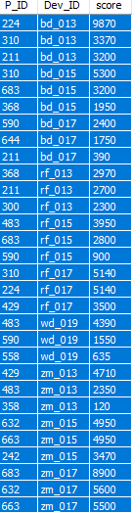
Q13) Extract top 3 highest sum of score for each device id and the corresponding player_id
Result
SQL Query
with task as(select P_ID,Dev_ID,sum(Score) as score,row_number() over(partition by Dev_ID order bysum(Score) desc) as Ranked from level_details2 group by P_ID,Dev_ID)select P_ID,Dev_ID,score from taskwhere Ranked<4;

Slide 19
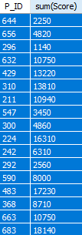
Q14) Find players who scored more than 50% of the average score, scored by the sum of scores for each `P_ID`.
Result
SQL Query
select P_ID,sum(Score) from level_details2 group by P_IDhaving sum(Score) >0.5*(select avg(Score) from level_details2);

Slide 20
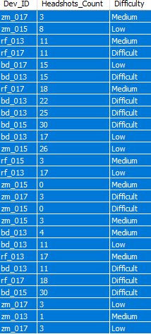
Q15) Create a stored procedure to find the top `n` `headshots_count` based on each `Dev_ID` and rank them in increasing order using `Row_Number`. Display the difficulty as well.
Result
SQL Query
Create Procedure TopN(IN n INT)select Dev_ID,Headshots_Count,Difficulty From(select Dev_ID,Headshots_Count,Difficulty,row_number() over(partition by P_ID order byHeadshots_Count) as Ranked from level_details2)as taskwhere Ranked<= n;call TopN(9)

Slide 21
Thank you

